Slide 2
(5 + 9 )–( 2 x 3)

Slide 3
?

Slide 4
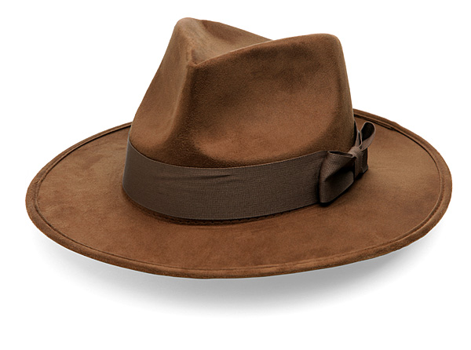

Slide 6
(3 x 2 – 1) + (25/5)

Slide 7
?

Slide 8


Slide 10
7 – 5 + 4 x 2

Slide 11
?

Slide 12
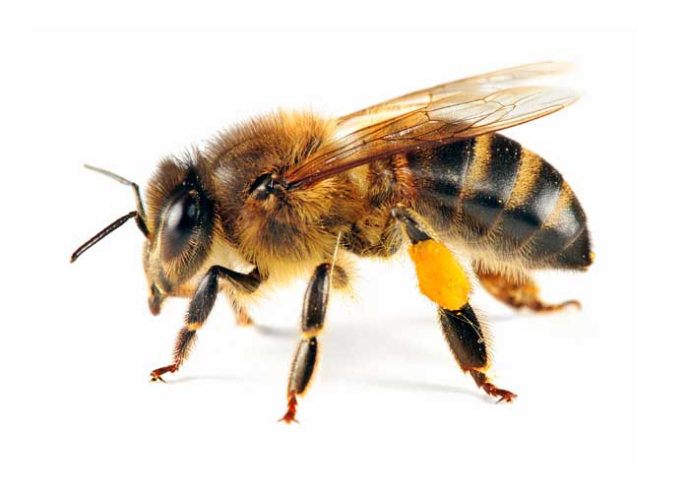

Slide 14
8 + 3 x 4 - 5

Slide 15
?

Slide 16
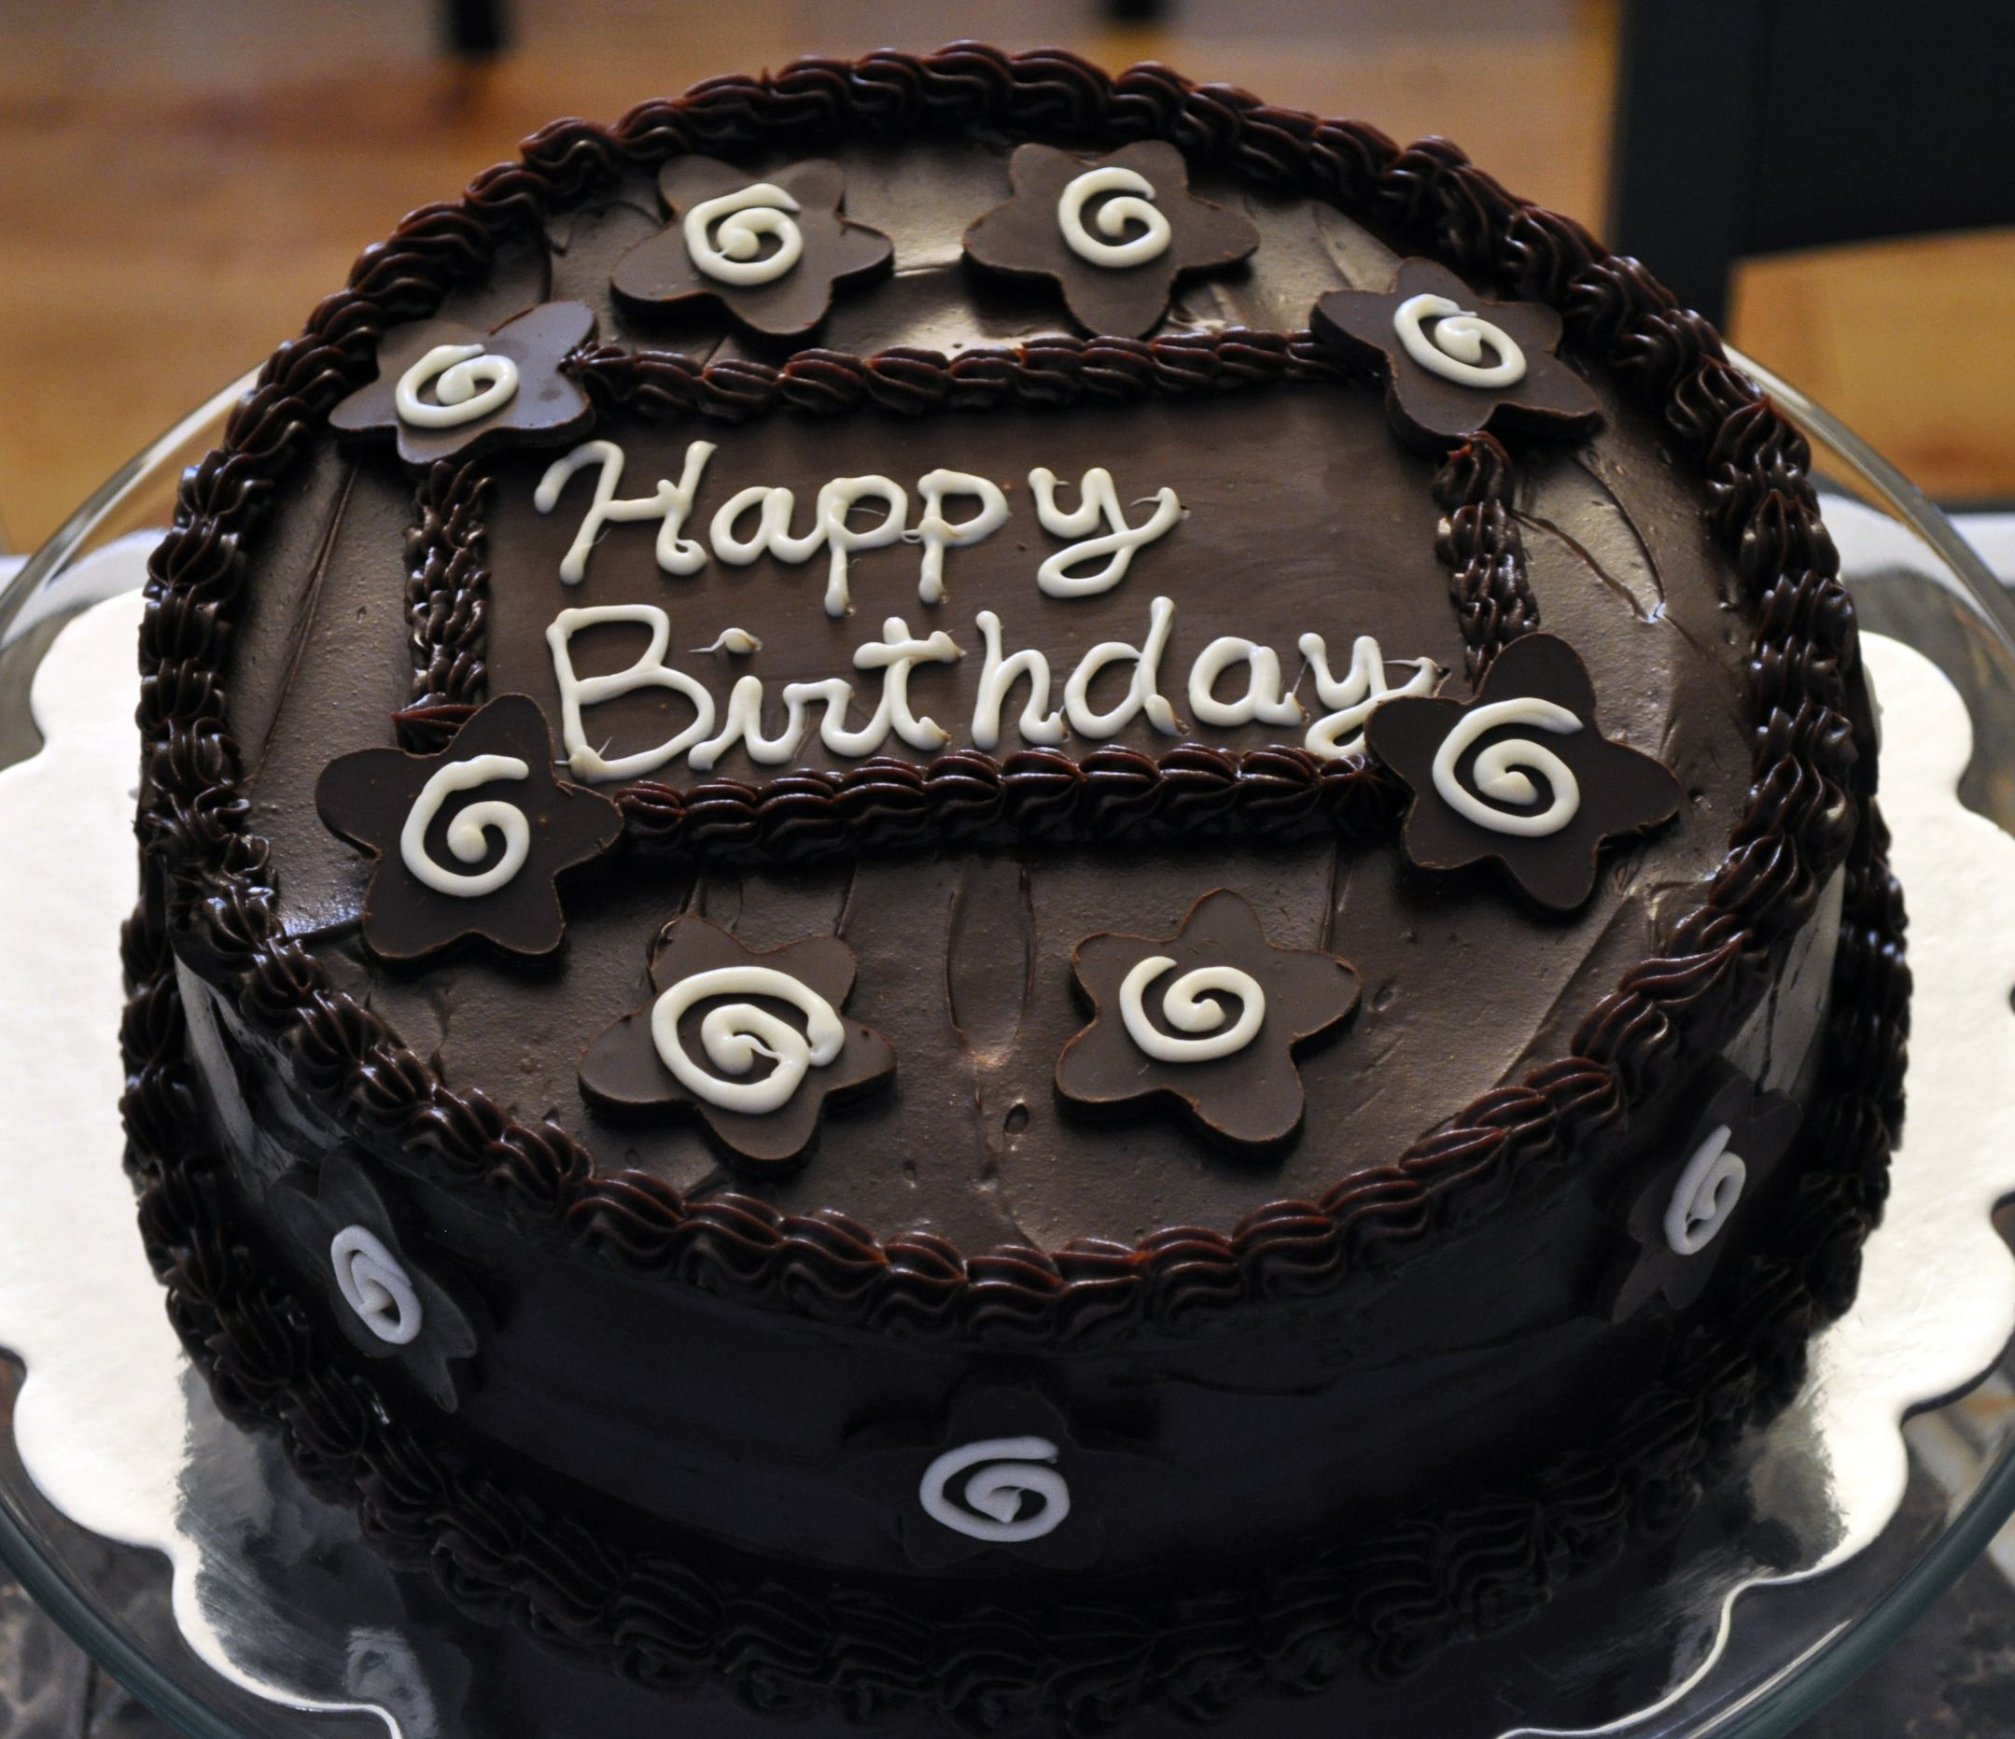

Slide 18
33/3 + 8 - 2

Slide 19
?

Slide 20
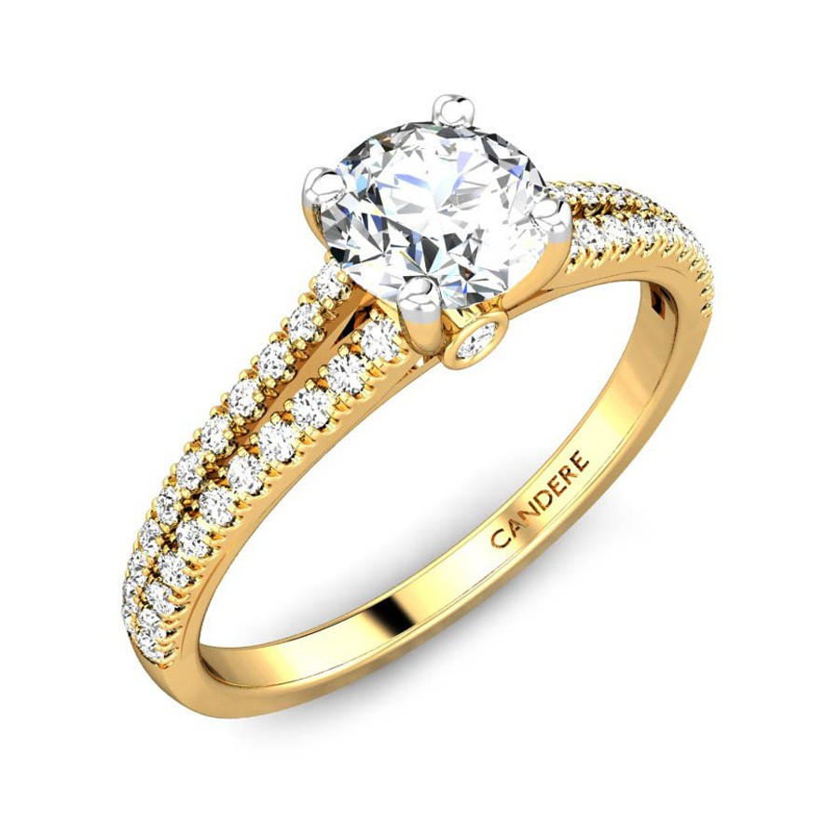

Slide 23
Average Reaction Times: Monolingual – 21.72 s Bilingual – 14.06 s

